Slide 1

2023
Advanced Programming
Module Code: B8IT150_2223_TME2
Examiner: Paul Laird
Date: 01/06/2023
Student: Rafael Dias do Couto - 10591357

Slide 2
Technologies / tools used:
The techniques used in the overall design to give accessibility for the system to be fully compliant with FLASK. The development of this website is using the languages HTML, PYTHON, CSS (Bootstrap), MySQL, json
as: Flask, flask_bootstrap, flask,mysqldb,wtforms, Flask_Login

Slide 3
Overview
Login / Note system
Register User
Add notes and delete notes
Login route:
Method used: 'GET', 'POST’
Request(POST): e-mail from form / password from form, it will Flash message in case of Logged in Successfully. If incorrect will Flash Incorrect password, try again
Authorization route:
Method used: 'GET', 'POST’
Request(GET): e-mail , Password, Password confirmation, in case that the e-mail has already been registered it will Flash Email already exists, after new register created if everything has match the conditions will redirect to sign up for login.

Slide 4
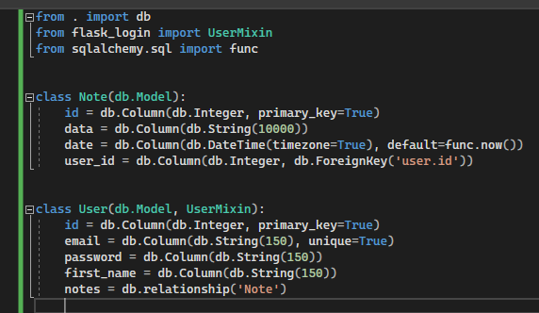
Database
Database was created with sqlalchemy.sql, that provides the tools and features for creating databases.

